Slide 1
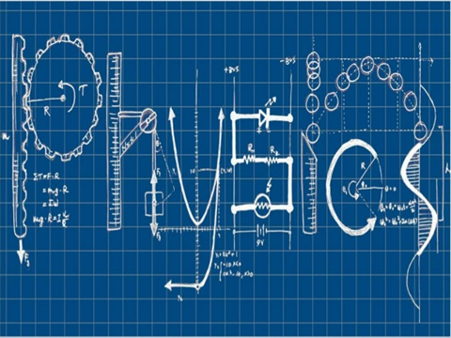

Slide 2
CONTENTS
APPLICATIONS OF PHYSICS-
VECTORS
RESONANCE
ULTRASONICS
DIELECTRICS
ACOUSTICS
INTERFERENCE
DIFFRACTION
POLARISATION
LASER

Slide 3
APPLICATIONS OF VECTORS
Vectors are used in many fields such as navigation of aeroplane, ship and satellite, they are also used in gene cloning.
They are widely used in mechanics, graphics etc.

Slide 5
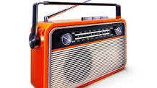
RADIO
In order to tune in to a particular radio station, adjust the natural frequency of the electrical receiving circuit in the radio to match that of the frequency of radio waves emitted by the station.
Resonance is thus used to isolate and amplify the required frequency.

Slide 6
APPLICATIONS
Microwave ovens
Heat up food through
radiation/electromagnetic
waves
Food mainly gets heated up due to the absorption of heat energy in the water molecules in the food

Slide 7
The frequency of microwaves corresponds to the natural frequency of water molecules.
The water molecules in the food placed in the microwave oven resonate when subjected to microwaves.
Thus, they absorb energy and consequently heat up the food, enabling the food to be cooked

Slide 8
APPLICATIONS OF ULTRASONICS
Ultrasonic sensors can measure the distance to a wide range of objects regardless of shape, color or surface texture. They are also able to measure an approaching or receding object.
Ultrasonic sensors can measure the distance to a wide range of objects regardless of shape, color or surface texture. They are also able to measure an approaching or receding object.

Slide 9
SONAR-SOUND NAVIGATION AND RANGING
Sonar is a technique that uses sound propagation to navigate, communicate with or detect objects on or under the surface of the water, such as other vessels.

Slide 10
Ultrasonic Drilling and Cutting
Ultrasonic are used for making holes in very hard materials such as glass, diamond etc., When ultrasonic are passed through these materials it creates air bubbles. This air bubbles collapses within short span of time, thereby a larger amount of pressure and temperature which are used for cutting and drilling.

Slide 11
ULTRASONIC CLEANING
Ultrasonic cleaning is an environmentally friendly alternative for the cleaning of continuous materials, such as wire and cable, tape or tubes.

Slide 12
Some other applications:
Ultrasonic guidance for the blind
Ultrasonic waves are used for guiding the blind who carries a walking stick containing an ultrasonic transmitter and receiver.
Ultrasonic signals reflected from any obstacles are fed to the head phones through a suitable electronic circuit which enables the blind person to detect and estimate the distance of the obstacle.

Slide 13
GENERAL APPLICATIONS
Material testing-
Following properties are determined-
Strength
Elasticity
Stiffness
Ductility

Slide 22
SOLID DIELECTRICS
Glass is used as dielectric in capacitors.
Mica is used as dielectric in high frequency applications.
Rubber is used in construction of storage batteries housings as well as it is used as insulating materials for electric wires,tapes,transformers and motor windinds.

Slide 23
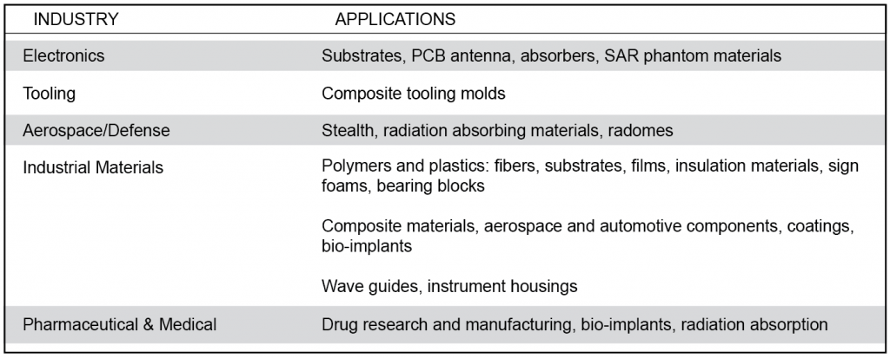

Slide 24
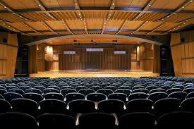
APPLICATIONS OF ACOUSTICS
Architectural acoustics (room acoustics and sound quality).
Design of variable acoustics rooms.
Analysis of sound insulation in buildings and acoustical rating.
Environmental acoustics and noise pollution (analysis of sound propagation in the external environment).

Slide 25
Interference is…
the process in which two or more light, sound, or electromagnetic waves of the same frequency combine to reinforce or cancel each other, the amplitude of the resulting wave being equal to the sum of the amplitudes of the combining waves.

Slide 26
Interference Patterns

Slide 27
TESTING OF OPTICAL FLATNESS
Interference is used to measured testing of optical flatness.
Flat surface
Spherical surface
Surface roughness

Slide 29
APPLICATIONS OF INTERFERENCE
Newton’s Rings
When a curved glass surface is placed in contact with a flat glass surface, a series of concentric rings is seen when illuminated from above by monochromatic light. These are called Newton’s rings.

Slide 30
Diffraction
Diffraction is the bending of waves as they pass through a gap or past an edge
When a wave (front) is Incident on an edge or an obstacle/slit/gap Wave ‘bends’ into the geometrical shadow/changes direction/spreads

Slide 31
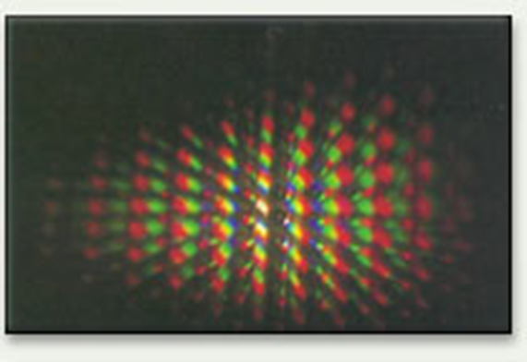
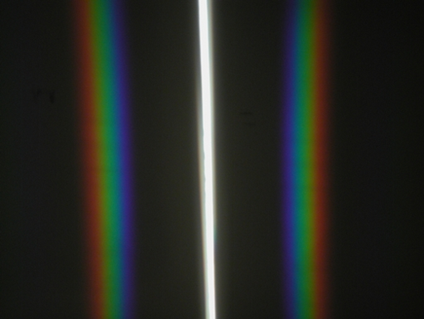
Diffraction Patterns

Slide 32
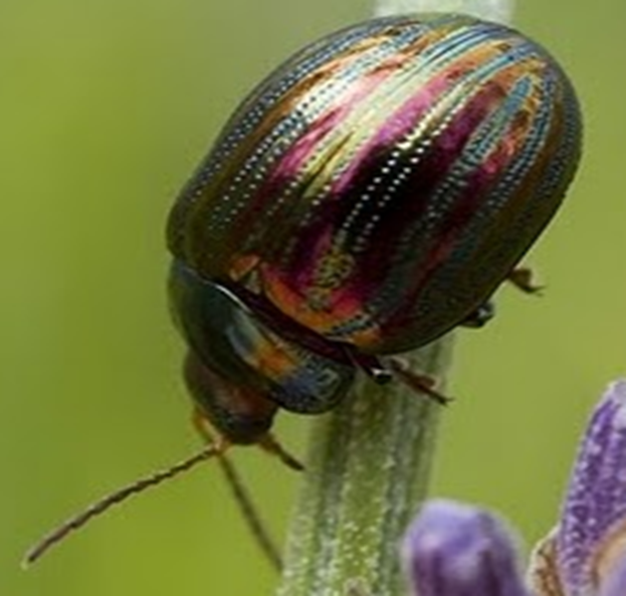
APPLICATIONS OF DIFFRACTION
The colors seen on a beetles back are caused by diffraction. Hard ridges cover the beetles back and the spaces between them cause diffraction like slits do. This produces interference effects. The ridges and slits enhance the interference pattern in series. A CD does the same thing, diffracting light between its grooves.

Slide 33
DIFFRACTION GRATING
Diffraction gratings are used to measure the wavelength of light. Diffraction gratings are made by scratching very fine lines on glass using the point of a diamond. The spaces between the scratches are like slits.
EX: jewelry creates spectrum like that on the surface of a CD.

Slide 34
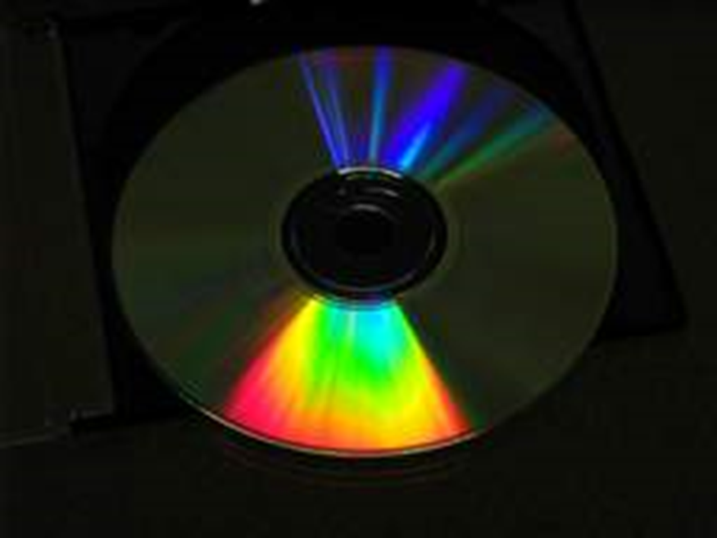

Slide 35
POLARISATION-3D MOVIES

Slide 36
Liquid Crystal Displays (LCD)
Liquid crystals can be found in many familiar applications, such as calculators and digital watches.
Color LCD displays are more complicated; each pixel has three subpixels to provide the different colors. A source of light is behind the display (unlike calculators and watches, which use ambient light). The pixels must be able to make finer adjustments than just on and off to provide a clear image.

Slide 37
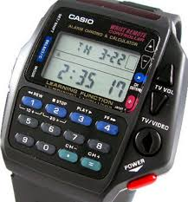
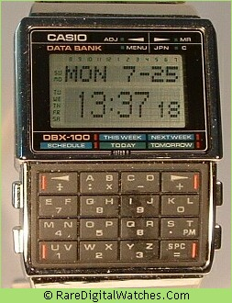

Slide 38
APPLICATIONS OF LASER
War machines, guns and tanks
Cutting matters in metallurgy industry and related industries
Robotics, especially in image processing and calculating distances
Toys

Slide 39
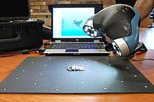
3-D LASER SCANNER FOR ACCURATE MEASUREMENT
A 3D scanner is a device that analyses a real-world object or environment to collect data on its shape and possibly its appearance (e.g. colour). The collected data can then be used to construct digital three-dimensional models.

Slide 40
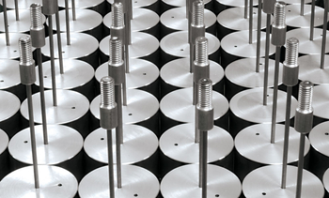
WELDING
Lasers have prevailed especially in sheet metal forming. The weld joints are highly stressable and optically appearing. Clean cutting areas, flexible contour guiding and permanent labelings can be produced quicker than with conventional techniques.

